Slide 1

COVID-19: Impact on Production of
Off-Highway Equipment In North America
June 17, 2020

Slide 2


Power Systems Research – Off-Highway Markets
Yosyf Sheremeta, PhD
Director of Product Management
and Customer Experience
Jim Downey
Vice President - Global Data Products
Yosyf brings over 20 years of data modeling, forecasting and analysis, including 15 years in off-highway OEM markets. He is responsible for the global management and forecasting components of the company's leading proprietary databases, OE Link™ and EnginLink™. He also has responsibilities for customer experience, including new business development, and database user training.
Jim brings 20+ years of industry market research experience with a focus on North American off-highway segments. He is responsible for database management, customer collaboration and project support. He also has responsibilities for managing, training and supporting the company’s global analyst database team and the technology service group.

Slide 3
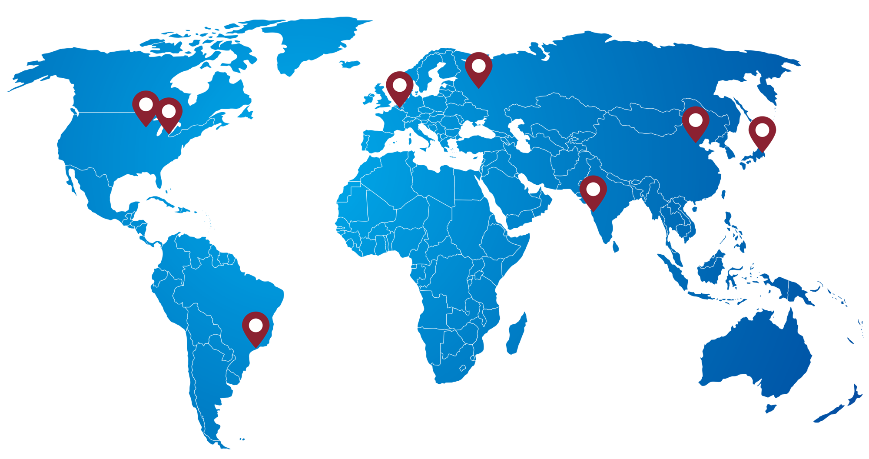
Powerful expertise, innovation for the future
Global market research, industry data & forecasting
  Utilized by engine manufacturers, OEMs, component and parts suppliers, associations, financial analysts, publications and more.
All segments; global power products/drivetrain industry
More than 40 years’ industry expertise
Proprietary market studies
In-house call center
Market intelligence & modeling

Slide 4




OEM, Engine & Alternative Powered Products
Production, Sales & Population Data
Agricultural
Construction
Industrial
Lawn & Garden
Light Commercial Vehicles
Marine Auxiliary
Marine Propulsion
Medium & Heavy Vehicles
Minivans & SUVs
Passenger Cars
Power Generation
Railway
Recreational Products

Slide 5









Macro-Economic Factors and Demand Drivers
Housing starts: 30% decline, driven by lockdowns
Economic Cycle: Complete reset across all industries
6.5% GDP decline in 2020
Infrastructure: road and transportation, water facilities, hospitals
Economy Shutdown, Reopening
and COVID Comeback Risks
Government Stimulus: Small Businesses
Direct investments
Labor market: 9.3% unemployment rate in 2020
Commodity: corn, soy, crude oil
Interest Rate will remain low through 2022
Product Demand Factors:
Regulations, Emissions, EV, Alternative Fuels, Technology Adoption, IoT

Slide 6
Supply Chain and Other Demand Drivers
Raw Materials
Components
Manufacturing
Distribution
Logistics: Ports, Air Freight shipping cost, container management
Inventory Management:
3+ Months oversupply
Future Orders and
Raw material oversupply;
Forging Activities Planning
Cash Flow Management:
Private vs Public ownership
Cost savings measures
Manufacturing:
Build Capacity Planning
Plant Location and Scenario analysis
Trade Tariffs: Cost sharing
Coding and Classifications
Value added manufacturing
Seasonality planning: Nov-Dec maintenance, Model year change
Product Portfolio Assessments, M&A

Slide 7
COVID-19 Impact on Industry Demand
Pre-COVID
COVID Recovery
Key points: Commodity pricing, weather, interest rates, trade, transportation and logistics
Key points: follows general economic cycle; government spending, commercial and housing starts, interest rates
Source: PSR

Slide 8


Global Overview – Agricultural Machinery and Construction Equipment Production
AG and Construction production are both declining globally in 2020: AG -9.4% / CN -11.3%
Slight recovery for Construction equipment in 2021, but not until 2022 for AG machinery
AG sector recovery will depend on overall economic recovery from COVID-19 crisis
Construction segment will not return to pre-virus crisis volumes for another few years, at best
Source: OE Link™ Production – Forecast Database

Slide 9

North America Overview - Agricultural Machinery
2020 Projected Declines:
Ag Tractors: -13% - Largest Impact
Windrowers: -6% - Slightest Impact
Ag to decline 12-13% in 2020, segment has declined over the past few years and was set to recover this year
Growth cycle is typically around 4-5 years
Shortage of food/meat processing plants; dairy farm crisis
Source: OE Link™ Production – Forecast Database
Demand drivers include commodity prices, global trade/tariffs, interest rates, weather conditions and subsidies

Slide 10

North America Overview - Construction Equipment
2020 Projected Declines:
Scrapers: -20% - Largest Impact
Graders: -4% - Slightest Impact
Construction market to decline 14.2% in 2020
Government spending may put some infrastructure investments on hold (water systems), but add new projects (hospitals, highways, etc.)
Supply chain disruptions making building materials more difficult to get for contractors and on construction jobsites
Source: OE Link™ Production – Forecast Database
Housing: despite low inventory, new starts will be low in 2020-2021
Smaller equipment OEMs and rental companies suffered the most in the short term

Slide 11
Highly Visible North American Agricultural & Construction Applications
Source: OE Link™ Production – Forecast Database
Source: OE Link™ Production – Forecast Database
Ag Tractor production down 12.6% for 2020
Excavator production down 14% for 2020
Combine production down 10.8% for 2020
Skid Steer Loader production down 15% for 2020
Wheel Loader & Dozer production down 14.2% for 2020

Slide 12


Conclusion
COVID-19 Recovery: slow but steady
No V-shape type scenario on the horizon in North America
Government Support/Intervention
Off-Highway suffering less than On-Highway and Consumer markets
Double-digits declines in Ag and Construction
Markets will continue to evolve and adjust

Slide 13
Power Systems Research – Global Offices and Affiliates*
Power Systems Research, Inc.
World Headquarters
St. Paul, MN USA
info@powersys.com
Power Systems Research SA
European Headquarters
Brussels, BELGIUM
infobr@powersys.com
Power Systems Research (Beijing) Co., Ltd.
Beijing, CHINA
infocn@powersys.com
Power Systems Research, Inc.
Detroit Regional Office
Ann Arbor, MI USA
infode@powersys.com
PSR Power Systems Research India Pvt. Ltd.
Pune, INDIA
infoin@powersys.com
Power Systems Research
Far East / SE Asia Research
Tokyo, JAPAN
infojp@powersys.com
Power Systems Research*
Campinas, BRAZIL
infosa@powersys.com
Power Systems Research*
Moscow, RUSSIA
inforu@powersys.com
Tohan Research, Inc.*
Tokyo, JAPAN
infojp@powersys.com
www.powersys.com

